Slide 1
Final Presentation
EMC Education Services
Data Science & Big Data Analytics
Predictive Analysis of getting a Loan (Arizona state)
Anvesh Muttavarapu, Bharadwaj Kundavaram, Trivikram Kavuru, Anirudh Chekuri, Jeevan, Rohith
04/28/2016
Notes:
EMC Ed Services CA and DCA Launch Master V8
‹#›

Slide 2
Project Goals
To develop a model which predicts the Loan Probability.
To consider personal demographic data and analyse if its inclusion makes a difference to the prediction.
To obtain the accuracy of the given model in terms of the thresholds that the stakeholders set in their discussion (75% and 50%).
To provide suggestions for the kind of general advice FPC can put on their advice page.

Slide 3
Situation & Project Goals
Situation
A financial planning company, FPC would like to expand the set of services they offer by creating an online site for loan advice.
FPC realizes that the customers are looking for fast responses and the online-service must provide an answer within 45 seconds.
The company hopes this online service will be a lead-in for customers to come to FPC for more focused, personal financial planning to achieve their life goals.
Goals of FPC Project
To develop a model which predicts the Loan Probability of their customers.
To provide suggestions for customers in selecting appropriate loans based on their data.

Slide 4
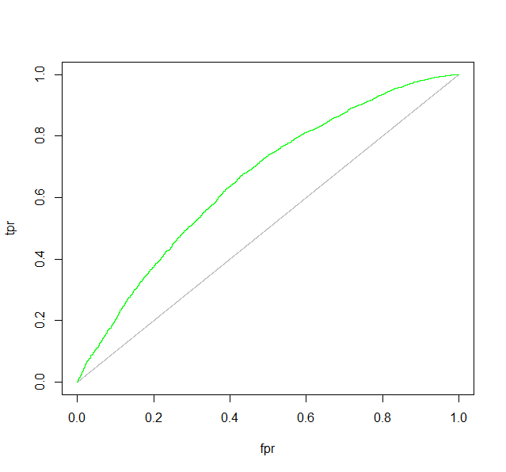
Executive Summary
Attained a ROC curve with Area under curve : 0.65897
Made two models.
With personal demographics.
Without personal demographics.
Insert graphic to support your main points
Concluded that personal demographics
doesn’t have much impact on the Loan
prediction.
Accuracy of prediction is demonstrated with the Data scores in thresholds bins (0.5,0.75).
‹#›

Slide 5
Approach
Acquired data from the FPC regarding their customer loan information and Customer personal demographic information .
Factorize information such as Loan Type, Loan Purpose ,Ethnicity etc.
Fields such as income,Rate spread, occupied units converted etc converted to numeric.
Fields such as Race,Ethnicity,County information are levelled to set references to Model.
Applied Decision trees to observe the Information Gain of all the Variable and understood important fields.

Slide 6
Approach
Used approximately 10% of the Data as an input to the Models.
Developed two Loan Predictor models in R , with and without demographic information.
Used ROC curves and Confusion Matrix to diagnose the Models

Slide 7
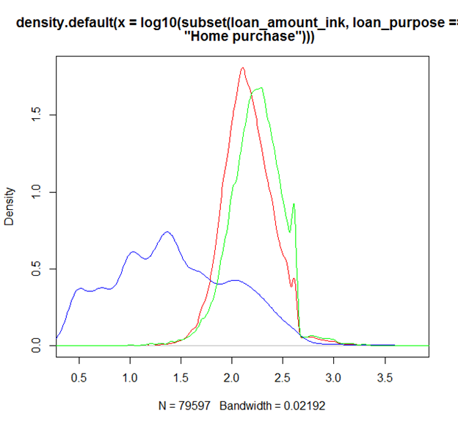
Data Cleaning
Checked for NA data and removed those records for more accurate analysis.
Eliminated small loans that trail out on the right.
Data with loan purpose as “Home Improvement”
were removed.
Used log to level the data

Slide 8
Model Description
Overview of Basic Methodology: Predict the probability of loan.
Model: Logistic Regression model
Dependent variable: Approved
Scope:
Design a two models, with and without Demographic information for FPC
Accept Inputs from the Customer and predict the probability of Loan approval
Give them suggestions on how to improve their chances of Loan
Sampling
Training sample: 12,400 applicants
Testing sample: 31015 applicants
The model developed has good predictive power and can categorise applicants into High,Medium and Low Probabilities
Models have Approved as a dependant variable and inputs like .Loan type,Loan purpose,Income,ethnicity etc
Two models have been designed with and without personal demographic information
Model uses data set filtered with loan amt <=400k,uses only two action types Originated , Denied
Model uses ROC/AUC curves , Histograms plots of scores ,Confusion Matrix for diagnosis.

Slide 9
Model Details
Total of eleven input variables used in the Full model including personal information . variables such as County,ethnicity are levelled and some references are set to the model.
Through data visualization we have cleaned the Datasets . We have filtered some data with Nulls and NA across many variables.
Full Model with Logistic Regression model built in R :
Fullmodel = glm(approved ~ loan_type + loan_purpose +
log10(loan_amount_ink) + log10(applicant_income_ink) + lien_status
+ applicant_race_1 + applicant_ethnicity + applicant_sex +
county_name + minority_population_pct+tract_median_income_ink,
data=smallset, family=binomial(link="logit"), na.action=na.exclude)

Slide 10
Model Details
NoPersonal Data Model:
modelNoPersonal = glm(approved ~ loan_type + loan_purpose +
log10(loan_amount_ink) + log10(applicant_income_ink)+ lien_status +
county_name+"minority_population_pct", "tract_median_income_ink ,
data=smallset, family=binomial(link="logit"), na.action=na.exclude).

Slide 11
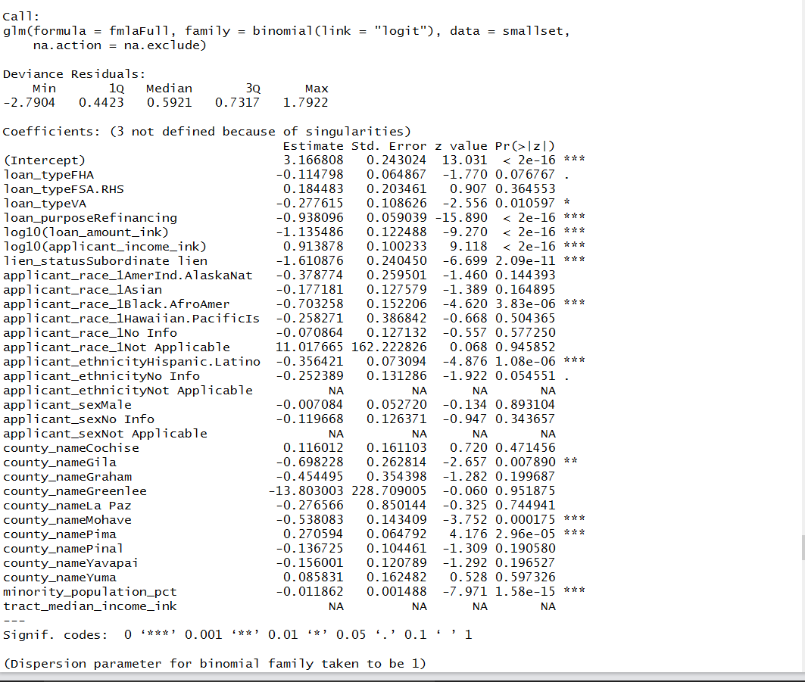
Model Results

Slide 12
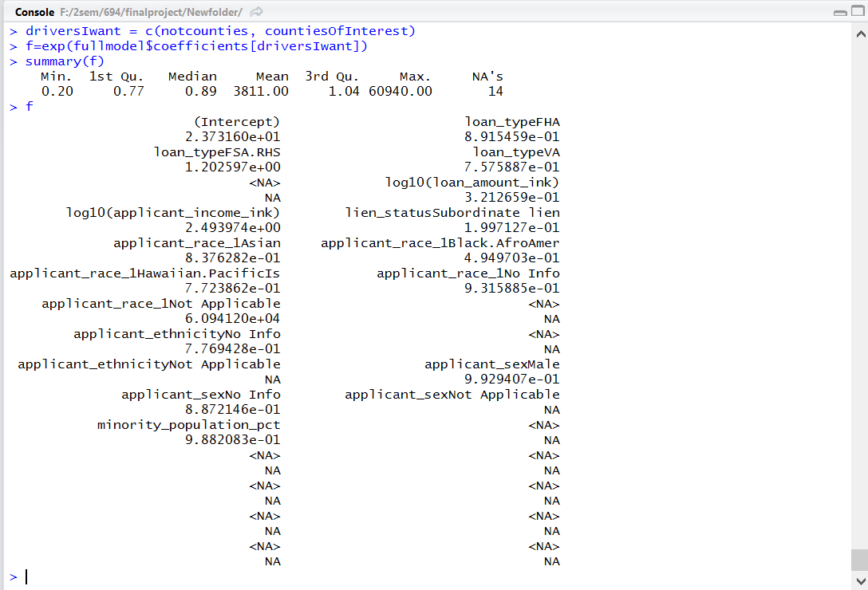
Model Results
Impacts of the Each Variable via Exp() function

Slide 13
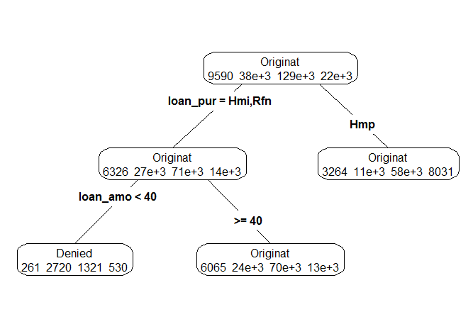
Decision Trees Results
Variable importance
loan_purpose 43
loan_amount_ink 27
lien_status 14
loan_type 12
minority_population_pct 2
applicant_ethnicity 1
county_name 1

Slide 14
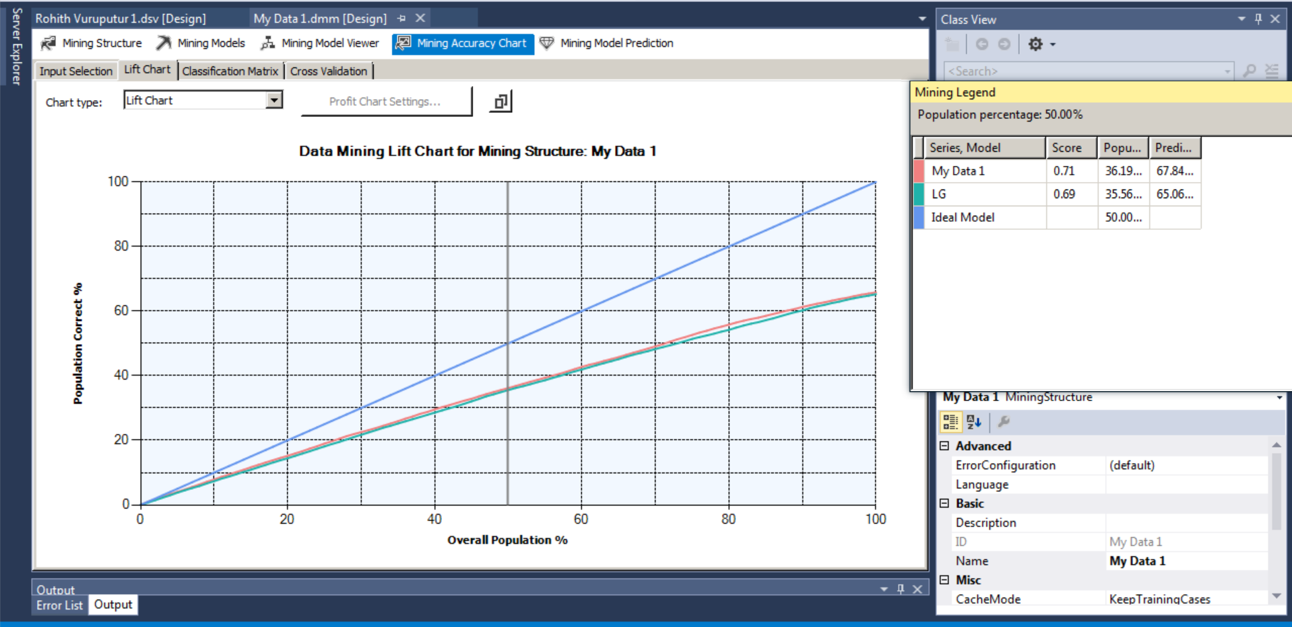
Results of Lift Chart from Microsoft Business Intelligence- Decision trees vs Logistic regression.

Slide 15
Diagnosis of the Models
Pseudo R^2 :1- (Deviance/Null Deviance)
For Full Model
0.0470725
For Model without Personal Data
0.04181282

Slide 16
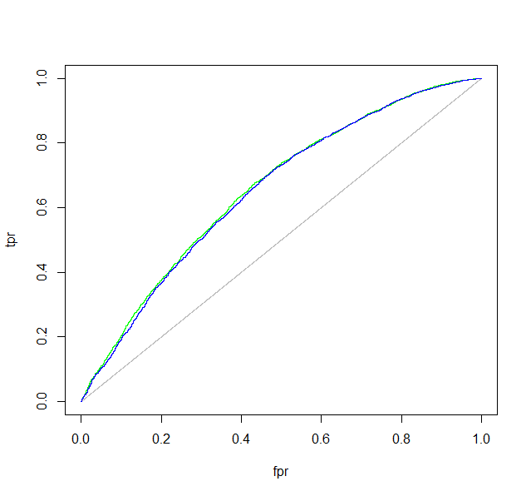
Diagnosis of the Models
ROC/AUC Curve
Area Under the Curve: 0.65897 (Full model),0.65387 (Without
Personal demographics)

Slide 17
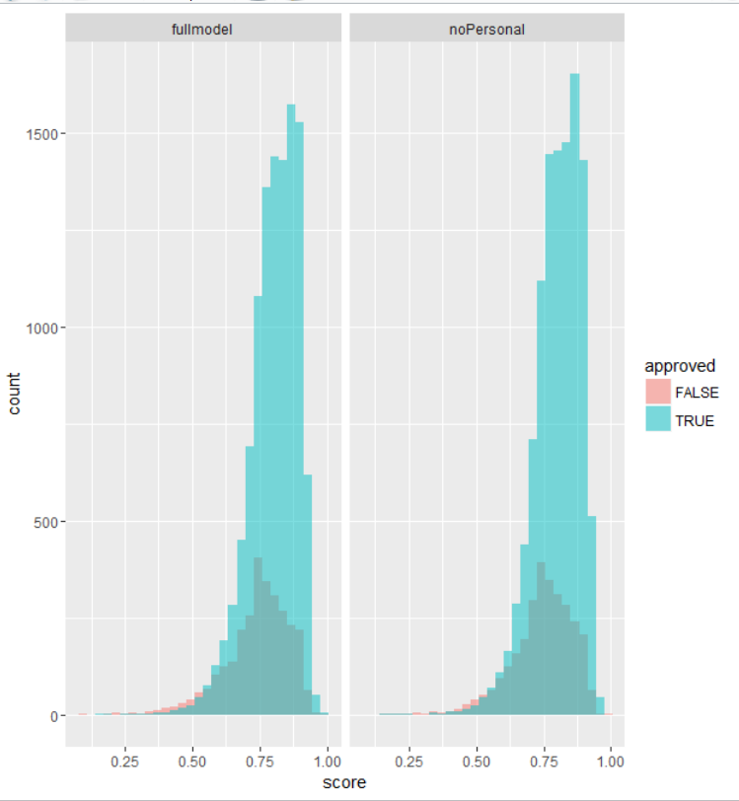

Score densities comparison plots -Approved and denied for Full Model and No Personal data Model
Diagnosis of the Models
Histogram plot of the scores

Slide 18
Recommendations
The company need not ask for personal demographic information of the customer because it doesn’t have significant impact on prediction.
We can suggest that Loan type of “Conventional” can help in increasing the Odds of Approval.
An increase in the applicant salary will increase the odds of approval by 2.4 .
Lien status as Subordinate will have a negative impact on odds of getting a Loan

Slide 19
Thank you

